Slide 1
Radar Signal Simulation and Processing Using FMCW Technology
(With MATLAB Toolboxes)
08/25/2020
MATLAB Documentations:
Radar Signal Simulation and Processing for Automated Driving
Automotive Adaptive Cruise Control Using FMCW Technology

Slide 2
Basic Procedure
Calculate Radar Parameters from Radar Requirements
Model Automotive Radar Hardware
Define Radar Signal Processing Chain
Model Free Space/Multipath(two-ary) Propagation Channel
Simulate the Scenario

Slide 3
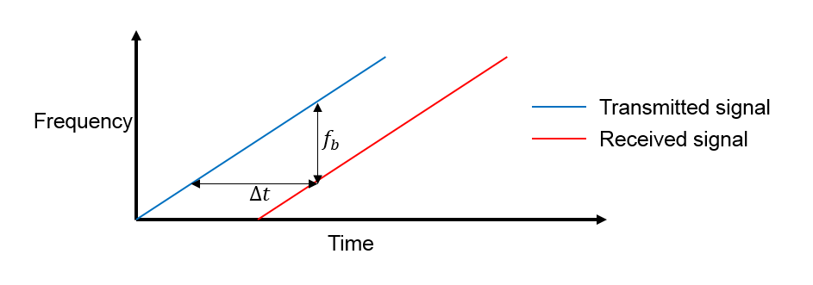
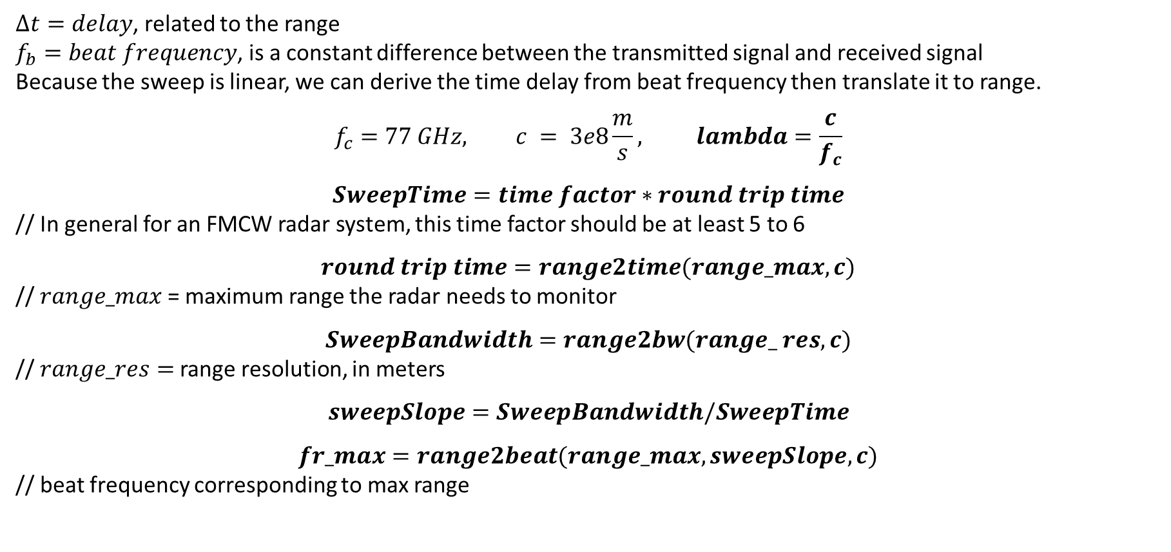
FMCW Parameter Calculations
$Δt=delay$, related to the range
$f_{b}=beat frequency$, is a constant difference between the transmitted signal and received signal
Because the sweep is linear, we can derive the time delay from beat frequency then translate it to range.
$$f_{c}=77 GHz, c = 3e8\frac{m}{s}, lambda=\frac{c}{f_{c}}$$
$$SweepTime=time factor∗round trip time$$
// In general for an FMCW radar system, this time factor should be at least 5 to 6
$$round trip time=range2time(range_max, c)$$
// $range_max$= maximum range the radar needs to monitor
$$SweepBandwidth=range2bw(range_ res, c)$$
// $range_res=$range resolution, in meters
$$sweepSlope=SweepBandwidth/SweepTime$$
$$fr_max=range2beat(range_max,sweepSlope,c)$$
// beat frequency corresponding to max range

Slide 4
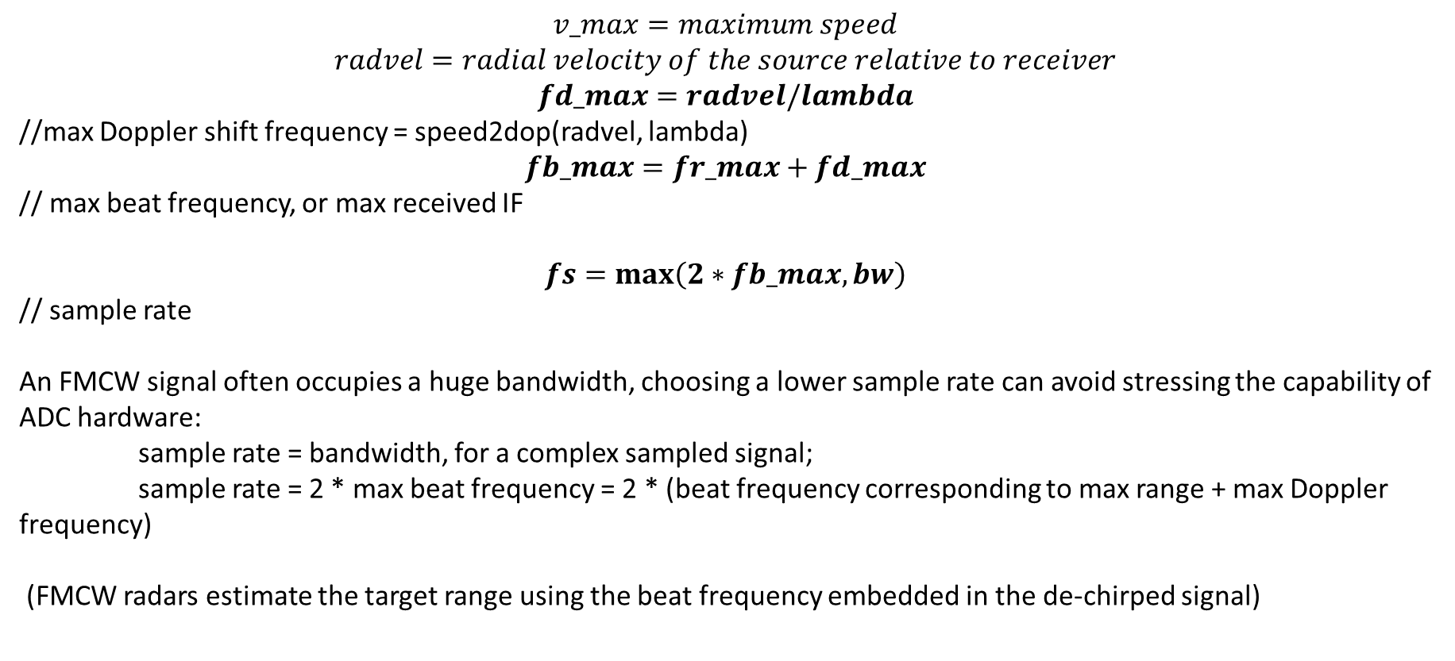
FMCW Parameter Calculations
$$v_max=maximum speed$$
$$radvel=radial velocity of the source relative to receiver$$
$$fd_max=radvel/lambda$$
//max Doppler shift frequency = speed2dop(radvel, lambda)
$$fb_max=fr_max+fd_max$$
// max beat frequency, or max received IF
$$fs=max\left(2∗fb_max,bw\right)$$
// sample rate
An FMCW signal often occupies a huge bandwidth, choosing a lower sample rate can avoid stressing the capability of ADC hardware:
sample rate = bandwidth, for a complex sampled signal;
sample rate = 2 * max beat frequency = 2 * (beat frequency corresponding to max range + max Doppler frequency)
(FMCW radars estimate the target range using the beat frequency embedded in the de-chirped signal)

Slide 5
Radar Parameters Summary
Operating frequency
Maximum target range
Range resolution
Sweep time
Sweep bandwidth
Maximum beat frequency
Sample rate

Slide 6
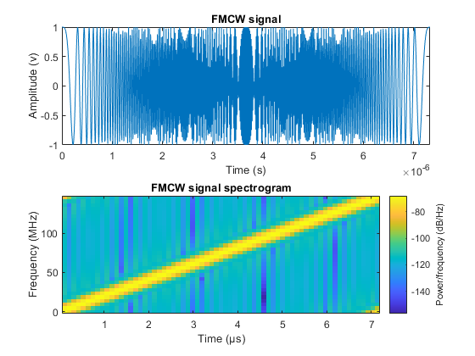
Set up Waveform
Phase Array System Toolbox, set up the FMCW waveform used in the radar system:
optional:
time-frequency plot of an up-sweep linear FMCW signal

Slide 7
Radar System Setup (Hardware)
Transmitter, Receiver, Antenna
(for simplicity, antenna is assumed isotropic, and its gain is included in transmitter and receiver)
Other hardware:
Antenna element model
Receive array
Beamformer
Root-MUSIC Estimator
Radiator for single transmit element
Collector for receive array

Slide 8
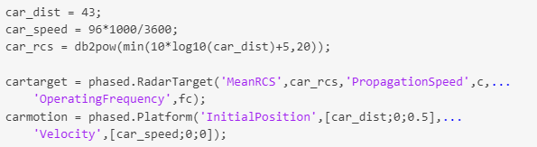
Target Model
Define distance between radar to target, speed of target
Calculate radar cross section of target based on distance between the radar and target
Create objects for target and its motion using PAS toolbox

Slide 9
Radar Signal Simulation
An FMCW radar measures the range by examining the beat frequency in the de-chirped signal.
To extract this frequency, perform a dechirp operation:
mixing the received signal with the transmitted signal -> IF signal
result:
dechirped signal contains only individual frequency components that correspond to target range
1. generates FMCW signal;
2. transmitter amplify the signal and radiate it into space;
3. signal propagates to target, get reflected to radar;
4. receiver collects the signal;
5. dechirp received signal and save it in a buffer;
6. when the buffer contains certain number of sweeps, perfrom FT in both range and Doppler to extract the beat frequency as well as the Doppler shift -> estimate the range and speed of target.

Slide 10
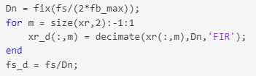


Range and Doppler Estimation
After the dechirp, only need to sample the received signal at a rate that corresponds to the maximum beat frequency.
Decimation of sample rate
Because max beat frequency < required sweeping bandwidth, the signal can be decimated to alleviate the hardware cost.
Root-MUSIC algorithm
Extracting both the beat frequency and Doppler shift

Slide 11
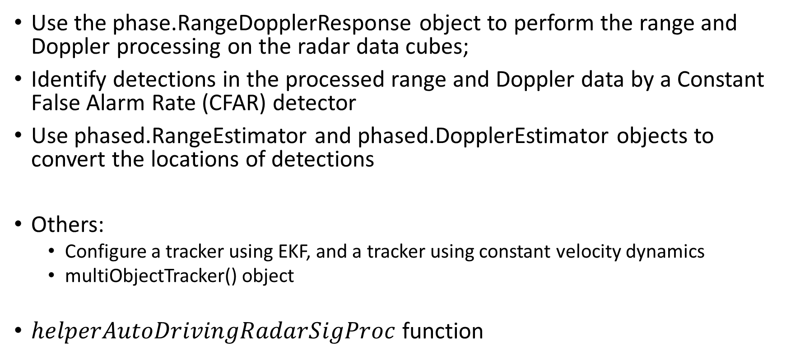
Define Radar Signal Processing Chain
Use the phase.RangeDopplerResponse object to perform the range and Doppler processing on the radar data cubes;
Identify detections in the processed range and Doppler data by a Constant False Alarm Rate (CFAR) detector
Use phased.RangeEstimator and phased.DopplerEstimator objects to convert the locations of detections
Others:
Configure a tracker using EKF, and a tracker using constant velocity dynamics
multiObjectTracker() object
$helperAutoDrivingRadarSigProc$ function

Slide 12
Issue: Range Doppler Coupling Effect
Target range corresponds to beat frequency -> an accurate range estimation depends on an accurate estimate of beat frequency
Doppler shift changes beat frequency -> biased range estimation
For example: the range error caused by the relative speed between the target and the radar is
deltaR = -0.0041 m <- sweep time = 7 us
deltaR = -1.118 m <- sweep time = 2 ms
A longer sweep time results in a lower sampling rate across the sweeps, thus reducing the radar’s capability of unambiguously detecting high speed objects.

Slide 13
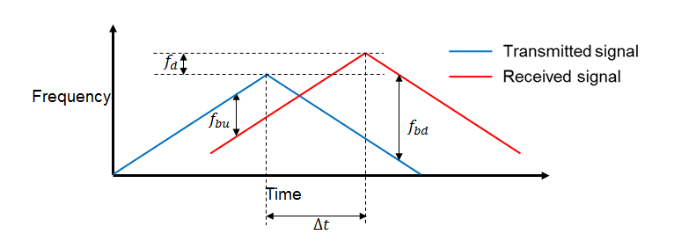
Solution: Triangular Sweep
To resolve the ambiguity by Range Doppler Coupling Effect without Doppler processing.
By combining the beat frequencies from both up and down sweeps, the coupling effect from the doppler can be averaged out

Slide 14
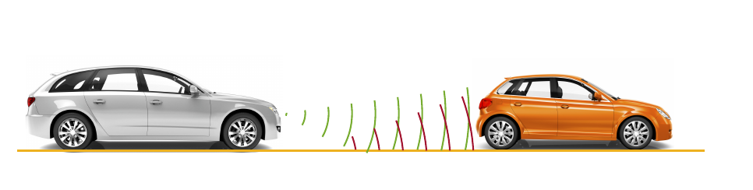
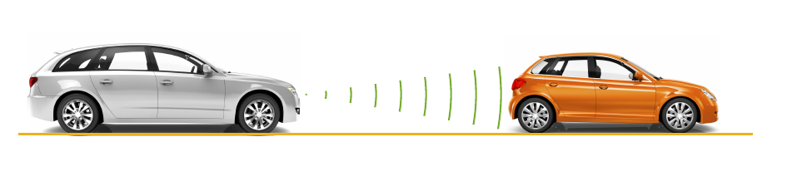

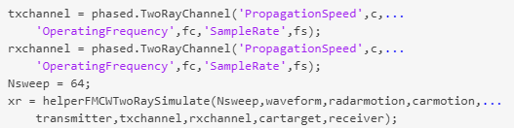
Free Space vs. Multipath Propagations
Free space channel: line-of-sight
Two-ary channel: line-of-sight and a single bounce from the road surface (constructive and destructive interference)

